Slide 2
Lecture 1
Welcome to CSCI0020 aka CS2
The Digital World
Fall 2024
Adjunct Professor of the Practice
Don Stanford
donald_stanford@brown.edu
don.stanford@gmail.com
Notes:
This lecture took about 45 minutes

Slide 3
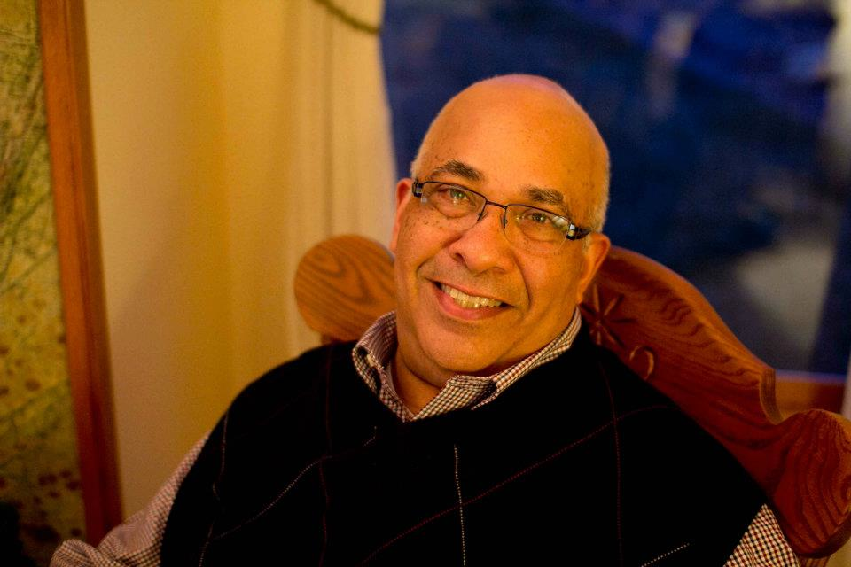
Who am I?
Brown class of 1972, AB, International Relations
ScM, Computer Science, Brown ’77
Chief Technology Officer of GTECH Corp/IGT 1979-2002, 2008-2018 (retired)
Adjunct Professor in CS and Engineering since 2002
Also teach Technology Leadership in Masters prog.
Business Innovation Factory
Spectra Systems and Slater Foundation Board
Advisor and Investor with Brown student entrepreneurs
Commute between R.I. and St. Thomas V.I. much of the year

Slide 4
Don’s Office Hours
I am always available directly before or after class or by request.
If you need a private meeting, please email me and we will schedule one asap.
donald_stanford@brown.edu

Slide 5
CS2 Teaching Assistants Fall 2024
Head TAs:
John Farrell (john_farrell@brown.ed
Yifan (Titi) Zhang (yifan_Zhang@brown.edu)
UTAs:
Cameron Sikich | cameron_sikich@brown.edu
Emily Perelman | emily_perelman@brown.edu
Gaby Choi | carmen_choi@brown.edu
Jitpuwapat Mokkamakkul | jitpuwapat_mokkamakkul@brown.edu
Justin Hickey | justin_hickey@brown.edu
Liam Capozza | liam_capozza@brown.edu
Logan Hines | logan_hines@brown.edu
Samantha Shulman | samantha_shulman@brown.edu

Slide 6
Embrace your TAs!
Remember,
The TAs are your friends and are committed to helping you with the course material and objectives.
  They are also full time students so please take that into consideration when you interact with them.

Slide 7
Course Material
Text: No Text!…Reading is assigned on the website (resources tab) or passed out in the labs
Lecture Videos: available on the CS2 website on Tuesday and Thursday
The CS2 website is a critical resource. When in doubt, go there first!

Slide 8
The CS2 Website
www.cs.brown.edu/courses/csci0020
Contains latest info on everything to do with the course (MOTD, Labs, Project Assignments, Lecture notes, Syllabus, Staff info, etc)
All assignments and lab links are posted there
as well as in Canvas
All assignments are submitted using a hand-in utility on the Canvas site which is also linked to the CS2 website
All grades are posted and can be checked on the Canvas site

Slide 9
Lectures
I will record all lectures in class they will be available for the duration of the course on our website. They will be available in both Powerpoint and full video formats.

Slide 10
Lectures
Introduction to the Digital World
A Short History of Computing
The Rise of the Internet – “Revenge of the Nerds”
Introduction to Data and Graphics
Computer Architecture
Software and Operating Systems

Slide 11
Lectures, continued
Legal Issues in Computing
Cyber Crime
Cyber Security/Midterm Review
Multimedia: Digital Audio
Multimedia: Digital Imaging
Multimedia: Digital Video

Slide 12
Lectures, continued
Databases and Privacy Issues
Writing a Program
Intro to Python
Digital Networks
Artificial Intelligence
The Computing Hierarchy

Slide 13
Lectures, continued
Crypto Currency, NFTs and Blockchain
No Lecture Thanksgiving Holiday
No Lecture Thanksgiving Holiday
Computer Gaming
The Internet of Things
Final Q&A session
12/08. Early OPTIONAL Final Exam
12/16. Final Exam
Final is (15% of Course Grade)

Slide 14
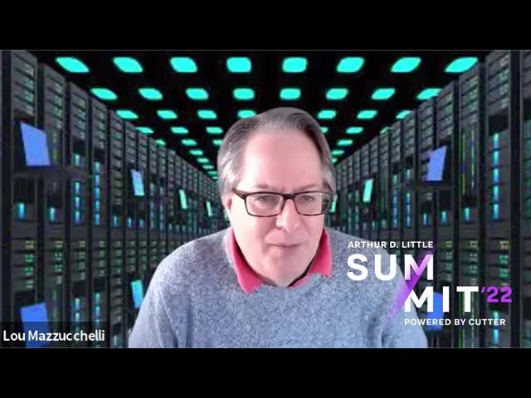
Guest Lecturer
Lou Mazzucchelli ‘77

Slide 15
Additional Reading Material
We will occasionally post suggested reading recommendations on the website. They are all available on the Internet
You are encouraged to read these items since they directly pertain to the lecture topics.

Slide 16
Labs (15% of Grade)
Lab assignments are designed to prepare you to understand and complete the Projects. All labs must be completed and checked off for credit.
Lab assignments comprise 15% of the final grade

Slide 17
Labs
Excel
HTML
CSS
JavaScript
Python Part One and Part Two

Slide 18
Projects (70% of Grade)
Excel
HTML
CSS
JavaScript
Python

Slide 19
Extra Credit!
All projects offer the opportunity to get extra credit. In addition the final exam also offers extra credit.
So, it is very possible to get more than 100 points for the course!

Slide 20
CS2 “Millionaire” Quiz Shows
Each Thursday during the lecture discussion session we will hold a review quiz show in which a lucky volunteer will have the opportunity to show the rest of the class how smart they are and how much they’ve learned!
Participants in the quiz show are eligible to win valuable prizes!
morning music, study guides, and…….

Slide 21


Slide 22
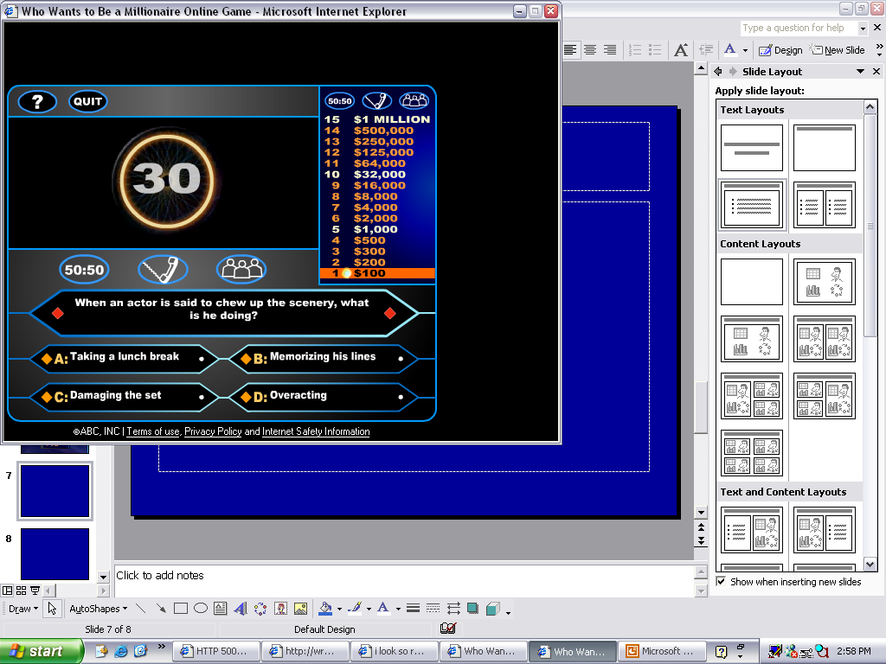

For $100
Don, the CS2 Instructor attended……
Princeton
Harvard
(sucks)
Slippery Rock
Brown

Slide 23
Grading
Project Assignments: 70%
Lab Homework: 15%
Final Exam 15%
Total available points 100+!
All Projects and Exams will offer extra credit points
Late Projects will incur a penalty!
Please DO NOT show up at the very end of the semester asking for more time to do all the projects!

Slide 24
Ed
We will be using a utility program called Ed (Edstem) for group questions and answers.
By submitting a question to Ed the TAs can answer it for all to see instead of answering the same question many times.
Ed can be accessed through the course CANVAS site or the website

Slide 25
Questions about the course mechanics ???

Slide 26
So,….Why learn about this Digital stuff ?
Useful for getting a job and providing you with the tools for a wide variety of work.
It’s fun and interesting in its own right.
Guaranteed to become even more important regardless of where you work or what you study in the future
Information Technology and Computer Science are the important keys to the ”knowledge economy”

Slide 27
The CS 2 Promise - Relevancy
You will know how computing and digital devices work to a greater level of understanding and how they affect our lives
You will leave this course with valuable new skills that will benefit you at work and study
You may be intrigued enough to pursue the subject further
You will have some fun along the way and meet some new cool people!
You will have a useful digital vocabulary and will be able to hold your own in any geeky conversations at cocktail parties or social events

Slide 28
So, if you are asked the question…
What do you want for your Birthday?
You will be able to reply, authoritatively:
“Well golly, I need a high-definition digital camera with an 18.2 mega-pixel low noise CMOS imager that renders 16K resolution due to its 9micron pixel size, complete with a 32 gig flash card and a Thunderbolt port for high-speed data transfers!”
And you will actually know what all of that means!

Slide 29
For those of you who are aspiring capitalists and entrepreneurs:
Competence in Computing and Information Technology is worth big $$$ in the job market!

Slide 30
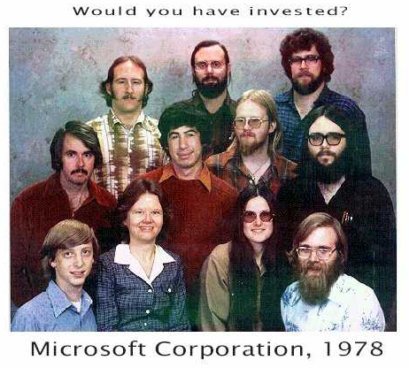
Bill Gates
Paul Allen

Slide 31
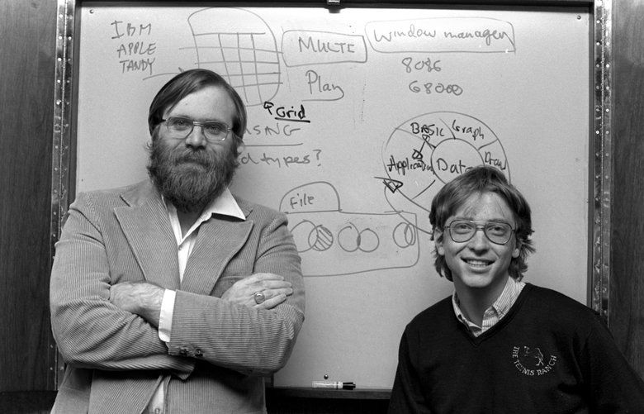

Slide 32
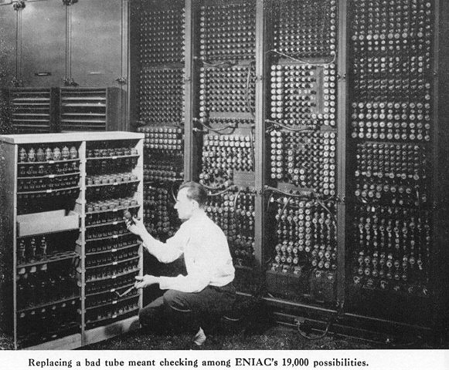
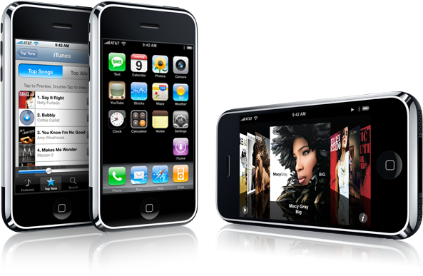
We will explore how we got from…
HERE….
To HERE …??????

Slide 33
The Computing Revolution
Distant Pre-history (prior to 1945)
Birth of “Digital” Computers around WWII
Repeated revolutions since then with computing technology becoming pervasive in all areas of technology, industry, entertainment, society and science

Slide 34
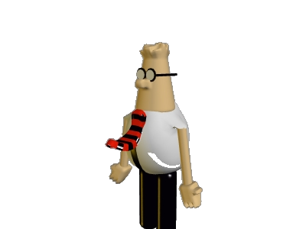

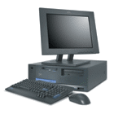
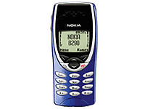
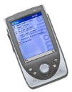
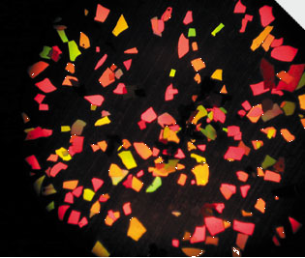
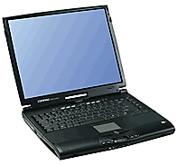
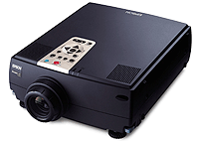
Trends towards Pervasive Computing
size
one computer, many people
one computer, one person
one person, many computers
smart dust
number

Slide 35
This trend is known today as the
“Internet of Things”
We will examine what that is and what its implications are

Slide 36
The Building Blocks
Hardware (the machine): the physical components of the computer - central processing unit, memory, input-output devices
Operating system: the software program that serves as a buffer between the user and the hardware
Software: the applications one uses or writes to get stuff done on the hardware

Slide 37
The Software Revolution
Relatively few people actually “program” computers. Most use software (programs) developed by others, intended to be used by people with limited understanding of how computers work, hence a huge market in commecial computer appications
E.g., spreadsheets, accounting, databases, powerPoint, word processing, web design, games, mathlab, computer aided design, graphics, imaging, simulation

Slide 38
The Communications and Multimedia Revolution
The Internet (email, world wide web, file transfers, messaging, mobile computing, etc)
The convergence of Computers, TV, Telephone, Multi-Media, Personal Digital Assistants that now communicate with each other in increasing numbers using a wide variety of media (images, video, sound, text, etc.)

Slide 39
All made possible due to Moore’s “Law”
The number of transistors that can be manufactured into a square inch of an integrated circuit doubles every 18 months or so. This means:
The amount of memory that can be supplied for a given cost doubles every 18 months or so and,
The speed of computation goes up by a factor of 2 about every 1.5 years for the same cost!
Gordon Moore, co-founder Intel Corp
made this observation 60 years ago!

Slide 40
Implications of Moore’s Law
The Apple iPhone would have needed more space than this room 40 years ago!
The equivalent amount of memory and computing power in your average PC would have cost >$3M 25 years ago!
A miniaturized computing device today can fit on a chip small enough to be injected into your blood stream and perform a diagnostics on your heart and send the results back using a wireless network.

Slide 41
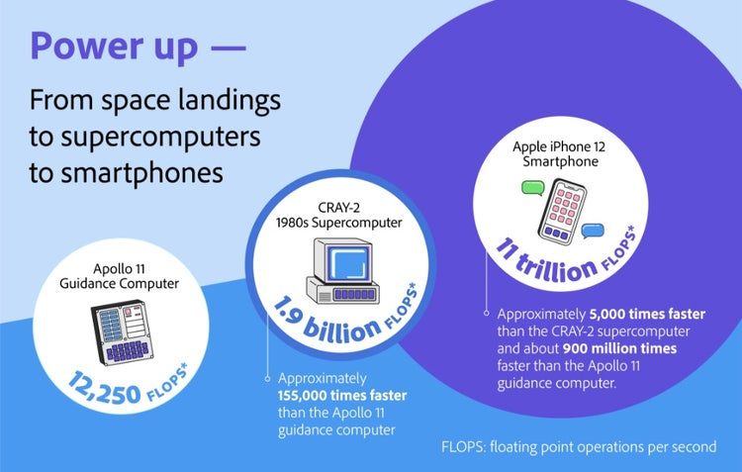
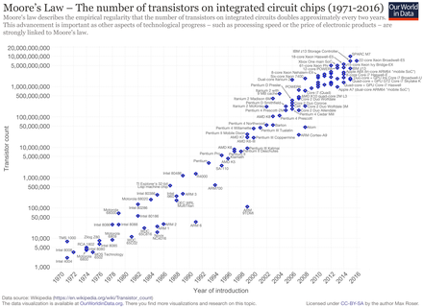
Moore’s law in action

Slide 42
The Emergence of a New “Law”
“Bandwidth” (the amount of information one can pump though a connection) doubles every nine months or so.
Interestingly, it seems that the amount of information we want to send doubles at the same rate, due in large part to the growth and commercialization of the internet.

Slide 43
Bits ( = Binary Digits)
Internally, all data in a digital device is stored in electronic devices that are either on or off (binary).
These devices are made from electrical components called transistors.
Thus all data can be thought of as being expressed in “bits”, where each bit is either on = 1 or off = 0. (also expressed as true/false)
In future lectures we will understand how using large numbers of bits, data can be stored and manipulated in a binary system at incredible speeds

Slide 44
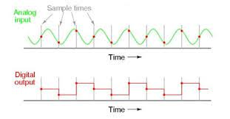
Analog to Digital Conversion….How does it work?

Slide 45
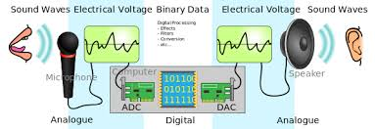
Sound around the world with the click of the mouse!
Analogue-to-digital conversion ...
britannica.com
In this course, you will gain insight into how all of this works!

Slide 46
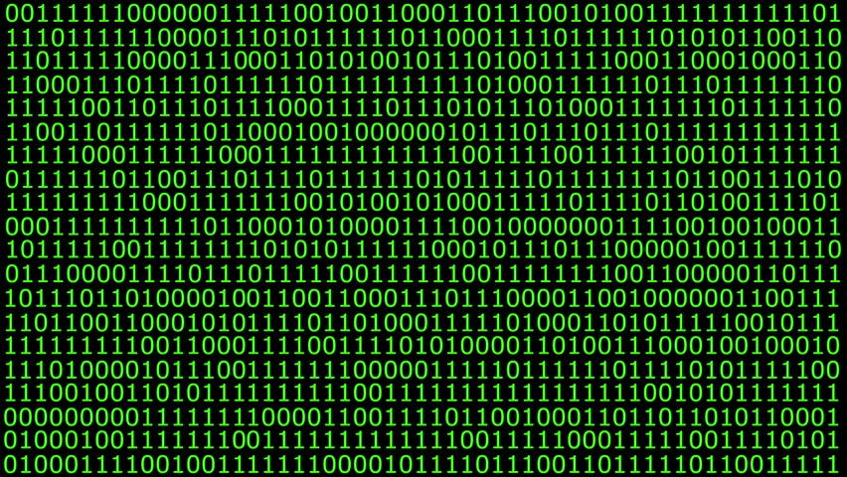
Inside the machine the binary looks something like this…
d

Slide 47
The Digital (Re)-Evolution
Some Examples
Digital Documents(Email, E-Books, Presentations)
Digital Music (CD, Streaming, Downloading)
Digital Imaging (CMOS Imagers)
Digital Video (DVD, Streaming)
Digital Television (HDTV)
Digital Communications (Internet, Wireless)
Digital Signatures and Identities!!!
Digital Money (Crypto Currency)
Digital Art (Non-Fungible Tokens)

Slide 48
Where Does This Flexibility Come From?
All data that the computer will work on, and the instructions it will execute (the software) , are stored in electronic digital memory in binary format.
Thus the same physical device, but loaded with different instructions and data, acts quite differently.
Each “App” is in effect a different and unique combination of 1’s and 0’s that the machine knows how to interpret

Slide 49
In Other Words,
Digital representation of information is now the norm
Affects practically every aspect of modern life
Similar to Medicine, advancements continue to occur at an ever quickening pace

Slide 50
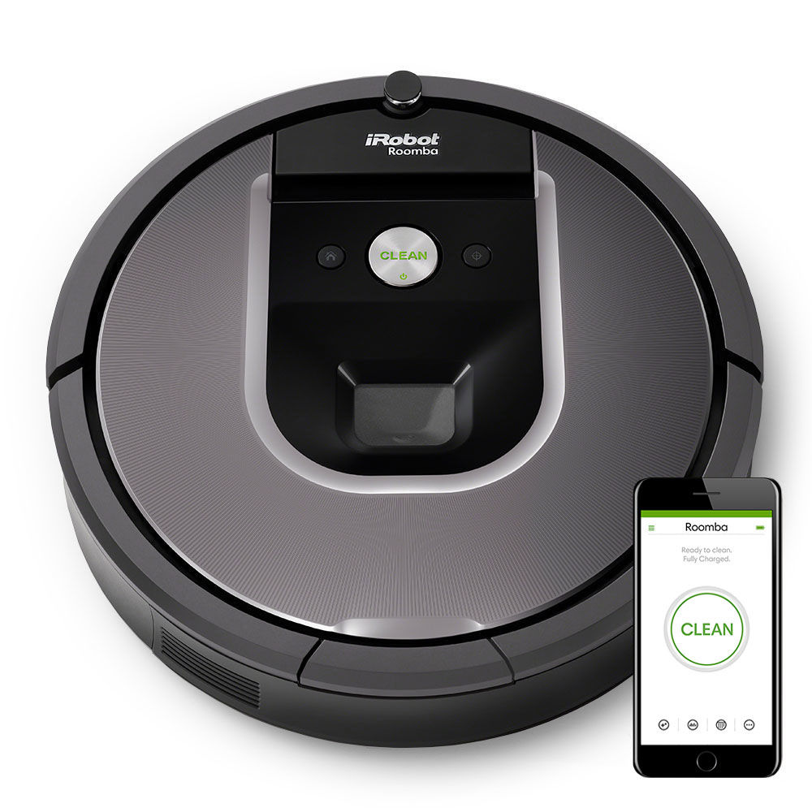
The Future that Was.….and Wasn’t
Past predictions that not totally succeeded: smart robots that clean your house, machines you can have an intelligent conversation with…
Well, we do have the Roomba!
In some cases we have greatly exceeded expectations
  computer inter-connection (the internet), computer graphics, animation, industrial robots, autonomous vehicles, increased flexibility and ease of use

Slide 51
What are some of the negative implications of all of this digital goodness?
  Privacy issues
  Cybercrime, Cyberfraud and Cyberwarfare
  Identity Theft
  Intellectual property disputes and lawsuits
  Propagation of “Fake News!” and misinformation

Slide 52
Summary
Today’s digital and computer systems are far more than computational and text processing tools
They enable a new communication paradigm
This paradigm is enhanced by the rapid expansion of the Internet and the applications that ride on it
It pervades society and everyday life in ways that we rarely appreciate or think about
In CS2 we will examine this phenomena from many aspects and give you useful tools that help you master it!

Slide 53
For more reasons to study CS..
Go to:
cs.brown.edu/courses/csci0150 and download the first lecture:
“A Gateway to Computer Science”

Slide 54

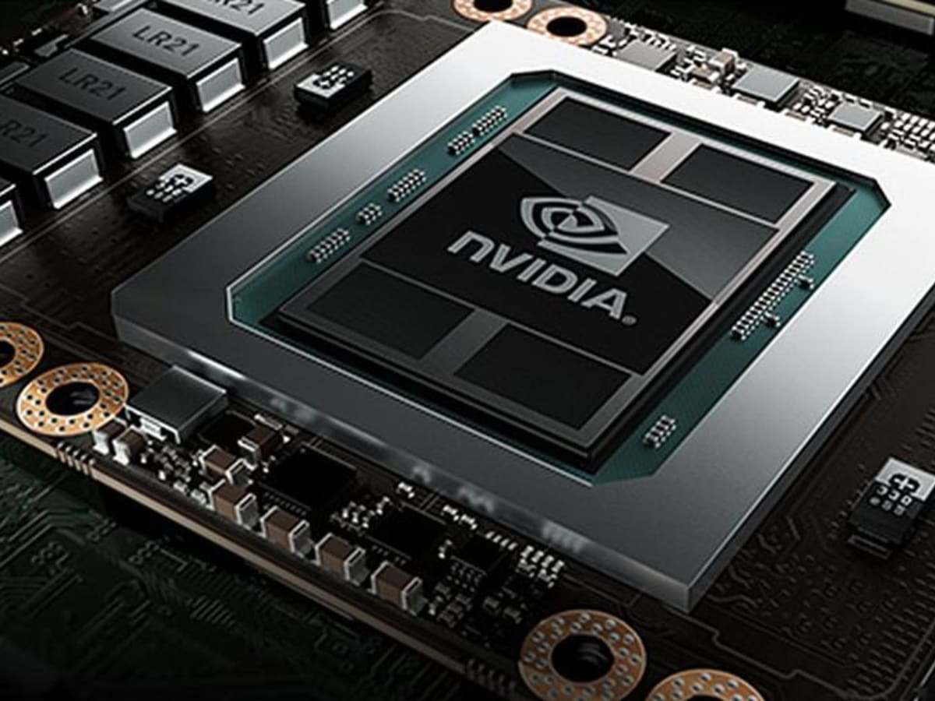
TheStreet
The New TRILLION $ Company!!

Slide 55
Questions?……

